Slide 1
SUPPORTO MULTIVITAMINICO E CHIRURGICA METABOLICA E BARIATRICA NUOVE EVIDENZE
Dr. Rosario BELLINI
U.O. CHIRURGIA BARIATRICA e metabolica
DAI Chirurgia e Medicina endocrino metabolica e dei trapianti
Ospedale «Nuovo Santa Chiara» Cisanello -Pisa

Slide 2
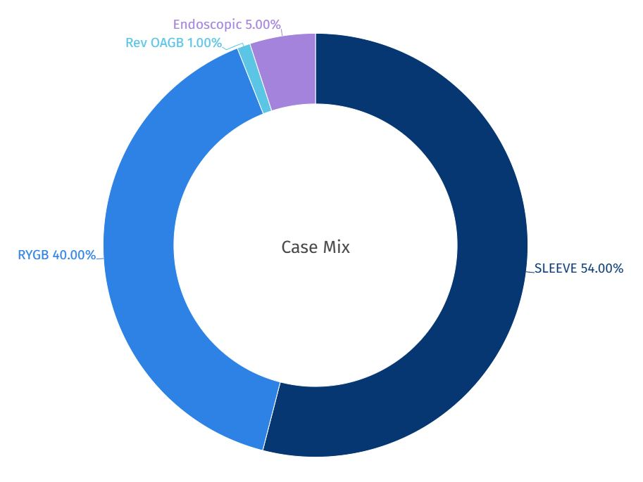
Disclosures
No Disclosures
Case Mix
Notes:
Questa il nostro case mix che include una quota sempre crescente di Endoscopia Bariatrica sia primaria che revisionale

Slide 3
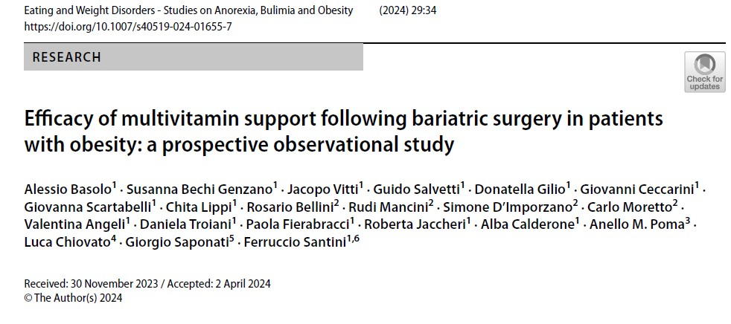
Study Background
Obesity Challenge
Surgical Solution
Obesity affects approximately 13% of adults worldwide, with a BMI equal to or exceeding 30 kg/m².
Bariatric surgery is the most effective treatment for severe obesity (BMI ≥40 kg/m² or lower with comorbidities).
Nutritional Concern
Surgery may lead to micronutrient deficiencies due to reduced intake and altered absorption.

Slide 4
Study Objective
Primary Goal
Supplement Design
Patient Safety
Evaluate the effectiveness of Bariatrifast (BIOITALIA S.r.l., Italy) in preventing micronutrient deficiencies after bariatric surgery VSG and RYGB.
Specifically formulated vitamin/mineral supplement to address post-surgical nutritional needs.
Assess tolerability and safety of the supplement in post-bariatric surgery patients.

Slide 5
Study Methodology
Patient Selection (recruited at the Obesity and Lipodystrophy Center,
University Hospital of Pisa from April 2021 to February 2023)
20 patients with severe obesity (mean weight: 123.5 kg, mean BMI: 43.3 kg/m²)
Mean age: 49.9 years (range 27-68)
Surgical Procedures
10 patients underwent Vertical Sleeve Gastrectomy (VSG)
10 patients underwent Roux-en-Y Gastric Bypass (RYGB)
Follow-up Schedule
Presurgical visit (V0) and follow-ups at 1, 3, 6, and 12 months (V1-V4)
Measurements
Weight, height, BMI, complete blood count, ferritin, folic acid, vitamin B12, calcium, vitamin D, PTH

Slide 6
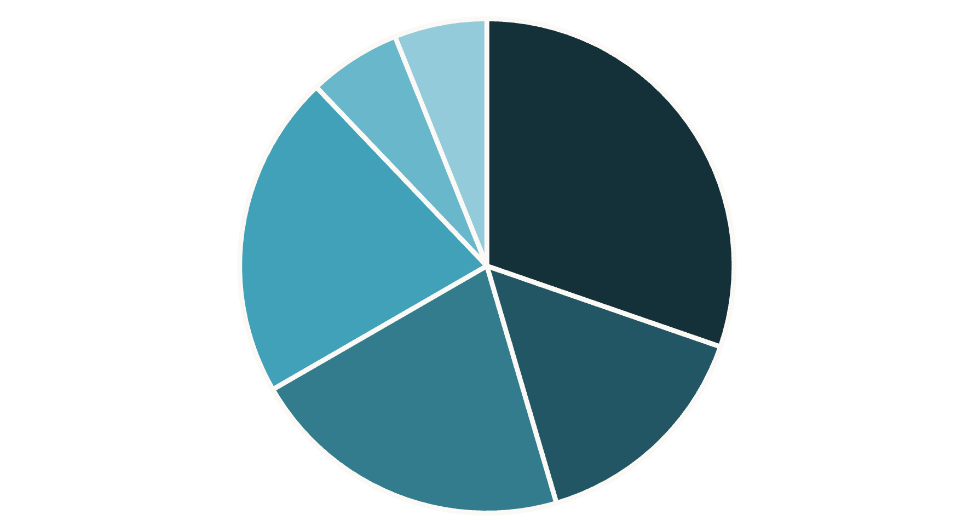
Comorbidities in Study Population
Sleep Apnea
NAFLD
Hypertension
The study population had various obesity-related comorbidities
Hypertension was most common (50% of patients)
Gastroesophageal reflux disease (GERD) 35%
Dyslipidemia 35%.
GERD
Type 2 Diabetes
Dyslipidemia

Slide 7
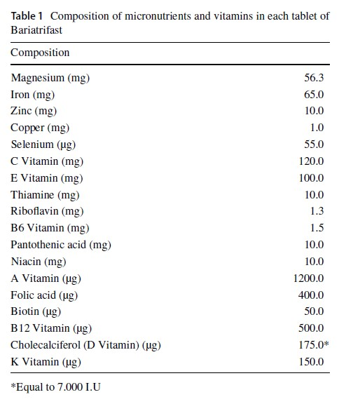
Bariatrifast Composition
Magnesium
56.3 mg
Iron
65.0 mg
Vitamin D
175.0 μg (7,000 IU)
Vitamin B12
500.0 μg
Folic acid
400.0 μg
Vitamin C
120.0 mg

Slide 8
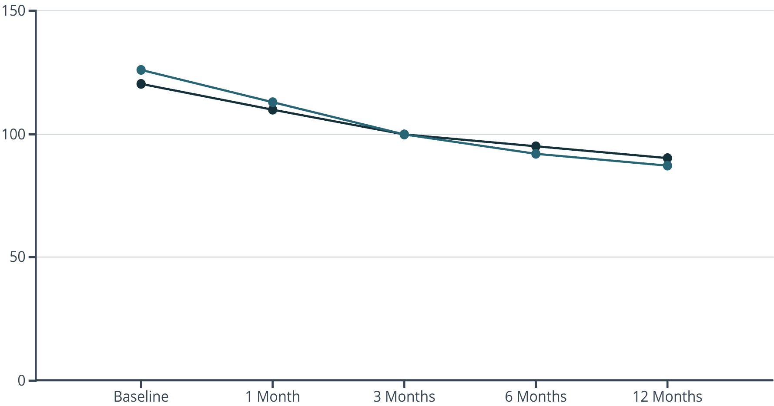
Weight Loss Results
VSG Weight (kg)
RYGB Weight (kg)
All patients achieved significant weight loss (mean -34.7±11.8 kg).
RYGB patients showed higher percentage of weight loss
(-31±7%) compared to VSG group (-25±8%), though not statistically significant.
Body Weight (kg)

Slide 9
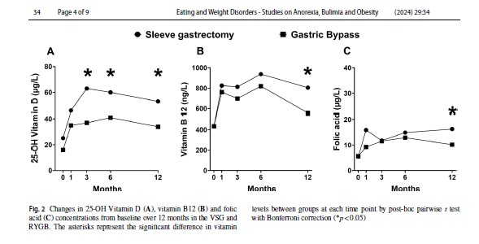
Changes in 25-OH Vitamin D vitamin B12 and folic acid
Asterisks represent the significant difference in vitamin levels between groups at each time point by post-hoc pairwise t - test with Bonferroni correction (*p < 0.05)

Slide 10
Vitamin D Results
1
Baseline (V0)
65% of patients had vitamin D deficiency (<25 μg/L)
2
3 Months (V2)
Significant increase in both groups, higher in VSG patients (p<0.05)
3
6 Months (V3)
Continued elevation, VSG group maintained higher levels (p<0.05)
4
12 Months (V4)
Mean increase of 23 μg/L from baseline, VSG group higher (p<0.05)

Slide 11
Vitamin B12 Results
243
7
ng/L Increase
Patients
Mean increase in vitamin B12 levels at 12 months
Achieved B12 levels >1,000 ng/L requiring formula adjustment
0
Deficiencies
No B12 deficiencies detected during the study period
VSG patients showed significantly higher vitamin B12 levels at 12 months compared to RYGB patients (p<0.05).

Slide 12
Folic Acid Results
Baseline Assessment
10% of patients (2 individuals) had folate deficiency (<3 μg/L) before surgery.
Supplementation Effect
Folic acid levels increased throughout the follow-up period with 400 μg daily supplementation.
12-Month Outcome
Mean increase of 8 μg/L from baseline. VSG patients showed significantly higher levels than RYGB patients (p<0.005).

Slide 13
Surgical Procedure Comparison
Vertical Sleeve Gastrectomy (VSG)
Roux-en-Y Gastric Bypass (RYGB)
Removal of approximately 80% of the stomach, creating a sleeve-shaped stomach.
Creation of a small stomach pouch connected directly to the middle portion of the small intestine.
Higher vitamin D levels at 3, 6, and 12 months
Slightly higher PTH values at 3 and 6 months
Higher vitamin B12 levels at 12 months
Greater percentage of weight loss (though not statistically significant)
Higher folic acid levels at 12 months
More pronounced reduction in nutrient absorption

Slide 14
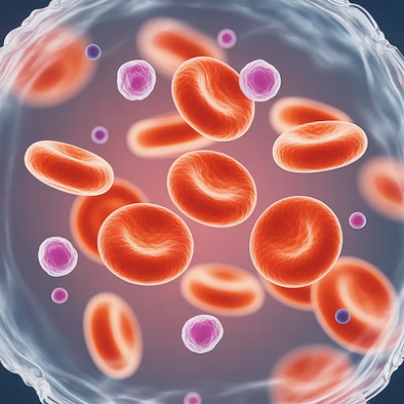
Other Blood Parameters
No significant changes were observed in blood counts, ferritin, or ionized calcium levels throughout the study. All parameters remained within normal ranges during supplement administration.

Slide 15
Supplement Adjustment
Monitoring
Regular blood tests to assess vitamin and mineral levels
Evaluation
Identify patients with elevated B12 levels (>1,000 ng/L)
Adjustment
Switch to Bariatric formula with lower micronutrient content
Seven patients (1 RYGB, 6 VSG) achieved vitamin B12 levels exceeding 1,000 ng/L at either 3 or 6 months. Their supplement was changed to Bariatric formula containing only 33 μg of B12 (vs. 500 μg in Bariatrifast), resulting in B12 levels declining below 1,000 ng/L.

Slide 16
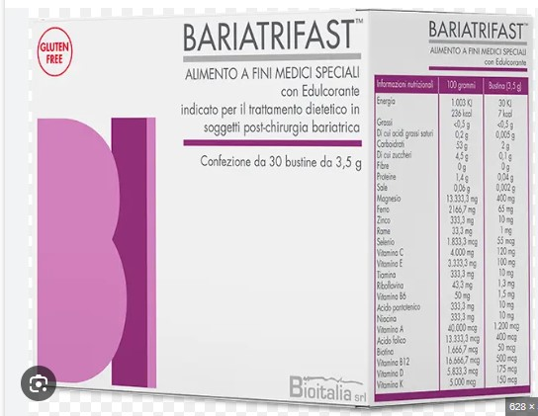
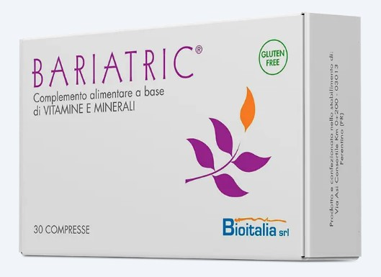
Bariatric vs. Bariatrifast Comparison
Nutrient
Bariatrifast
Bariatric
Vitamin B12
500.0 μg
33.0 μg
Vitamin D
175.0 μg (7,000 IU)
25.0 μg (1,000 IU)
Iron
65.0 mg
30.0 mg
Magnesium
56.3 mg
188.0 mg
Vitamin E
100.0 mg
12.0 mg

Slide 17
Patient Adherence
Daily Regimen
One tablet of Bariatrifast daily starting from the third day after surgery
High Compliance
Median adherence rate of 97.6% (range 77-100%)
Good Tolerability
No adverse events or side effects reported during the study

Slide 18
Pre-existing Nutritional Deficiencies
Vitamin D
Folic Acid
65% of patients had deficiency before surgery
10% of patients had deficiency before surgery
Vitamin B12
Iron
Literature reports 0-23% deficiency rates
Literature reports 0-47% deficiency rates
Patients with obesity often have poor nutritional quality diets and specific factors that contribute to micronutrient deficiencies even before surgery.

Slide 19
Mechanisms of Deficiency
Reduced Food Intake
Smaller stomach capacity limits nutrient consumption
Altered Digestive Tract
Bypassed sections reduce absorption surface area
pH Changes
Altered stomach acidity affects nutrient breakdown
Notes:
Bariatric surgery creates multiple challenges for maintaining proper nutrition. The reduced gastric pouch size in RYGB and rearrangement of the digestive tract in both VSG and RYGB lead to pH alterations that affect nutrient absorption.

Slide 20
Vitamin B12 Absorption Process
Gastric Degradation
Intrinsic Factor Binding
Vitamin B12 undergoes degradation in the acidic stomach environment
Stomach cells release intrinsic factor that binds to vitamin B12
Ileal Absorption
Duodenal Processing
Final absorption occurs in the ileum section of the small intestine
The binding process takes place in the duodenum
Notes:
When the intestinal tract is either bypassed or altered (e.g., after gastric bypass or duodenal switch), a reduction in vitamin B12 absorption may occur, explaining why RYGB patients showed lower B12 levels than VSG patients.

Slide 21
Vitamin D and Bone Health
Fracture Risk
Some studies show increased fracture risk after RYGB compared to other procedures.
Supplementation
Guidelines recommend at least 2,000 IU daily vitamin D supplementation after bariatric surgery.
Adipose Storage
Vitamin D is stored in adipose tissue; weight loss may increase serum levels as fat is lost.

Slide 22
Study Limitations
Sample Size
Relatively small population of 20 patients limits statistical power.
Control Group
Lack of control group undergoing specific dietary regimen without supplementation.
Follow-up Period
12-month duration may be insufficient to assess long-term nutritional outcomes.
Self-Reporting
Reliance on self-reported compliance with supplement regimens may introduce bias.

Slide 23
Additional Nutrients Not Measured
Bariatrifast contains additional vitamins (A, K, E, B6) and micronutrients (copper, zinc, magnesium) that may be deficient after bariatric surgery. However, the study did not specifically measure these levels to verify the supplement's efficacy for these nutrients.

Slide 24
Importance of Compliance
97.6%
1
Adherence Rate
Daily Tablet
Median compliance with supplement regimen in this study
Simplified regimen may enhance patient adherence
0
Deficiencies
No nutrient deficiencies detected with proper supplementation
Ensuring patients' compliance with multiple supplements can be challenging. Simplifying the regimen into a single product enhances adherence and minimizes the risk of nutritional deficits.

Slide 25
Clinical Implications
Preventive Approach
Personalized Dosing
Early administration of targeted supplements after bariatric surgery is crucial to prevent micronutrient deficiencies.
Regular monitoring allows adjustment of supplement formulation based on individual patient needs.
Healthcare Costs
Preventing nutritional deficiencies may reduce emergency admissions, hospitalizations, and treatment expenses.

Slide 26
Recommended Supplementation
Nutrient
General Recommendation
Special Cases
Iron
18 mg daily
45-60 mg for menstruating women
Vitamin B12
350-1000 μg daily oral
1000 μg monthly injection alternative
Folic Acid
400-800 μg daily
800-1000 μg for reproductive-age women
Vitamin D
At least 2000 IU daily
Higher doses for severe deficiency
Thiamine
1.2-10 mg daily
Higher doses for deficiency symptoms

Slide 27
Study Conclusion
Effective Prevention
Well Tolerated
High Compliance
Bariatrifast administration was associated with normal values of essential micronutrients throughout the follow-up period.
No adverse events or gastrointestinal side effects were reported during the study.
Good adherence to oral supplementation was observed with the simplified single-tablet regimen.
Personalized Approach
In the current study, the administration of Bariatrifast was associated with normal values of vitamins and minerals in patients with obesity who underwent BS. A satisfactory adherence to Bariatrifast treatment and its safety
were recorded
Monitoring allowed adjustment to lower-dose formula when needed for patients with elevated B12 levels.

Slide 28
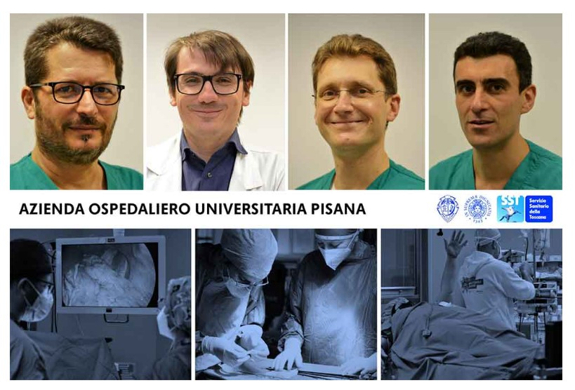
Grazie r.bellini@ao-pisa.toscana.it

